Slide 1
Raspberry Pi – Smart home
1. Setup Os & software

Slide 2
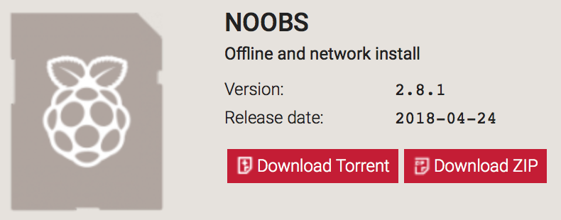
Raspbian noobs
Download Raspbian NOOBS
Format Micro SD card as FAT32 (exFAT will not work)
Copy the downloaded NOOBS to your micro SD card.

